Slide 1

JADN Sandbox
User Guide

Slide 2
High Level Table of Contents
JADN Sandbox Capabilities
Schema Creation
How to get started…
Schema Visualization
Schema Translation
Data Creation
Data Validation
Example Data Generation
Schema Transformation
Other Features
Docker Desktop
How to Get the JADN Sandbox Image
How to Run the JADN Sandbox Image
How to Update the JADN Sandbox Image
How to Stop the JADN Sandbox Image
How to Learn More about Docker

Slide 3
Low Level Table of Contents
Schema Creation
Feature: Editor Style
To Start
Add Data
Edit Data
Feature: Schema Tree
Feature: Types Outline
Feature: Hierarchy Viewer
Feature: Pattern Visualizer
More Functions and Features
Schema Transformation
Result: A Resolved Schema
Result: Strip Comments
Other Features
Theme Switcher
Add Custom Files
Remove Custom Files
Download Files
Schema Visualization
Results: Selecting One Language
Results: Selecting Multiple Languages
Schema Translation
Data Creation
View Data
Feature: Load/Save Builder
Feature: Magic Wand
Feature: Highlight Data
Data Validation
Invalid Results
Valid Results
Example Data Generation
Results

Slide 4
Schema Creation
Create valid JADN Schemas

Slide 5
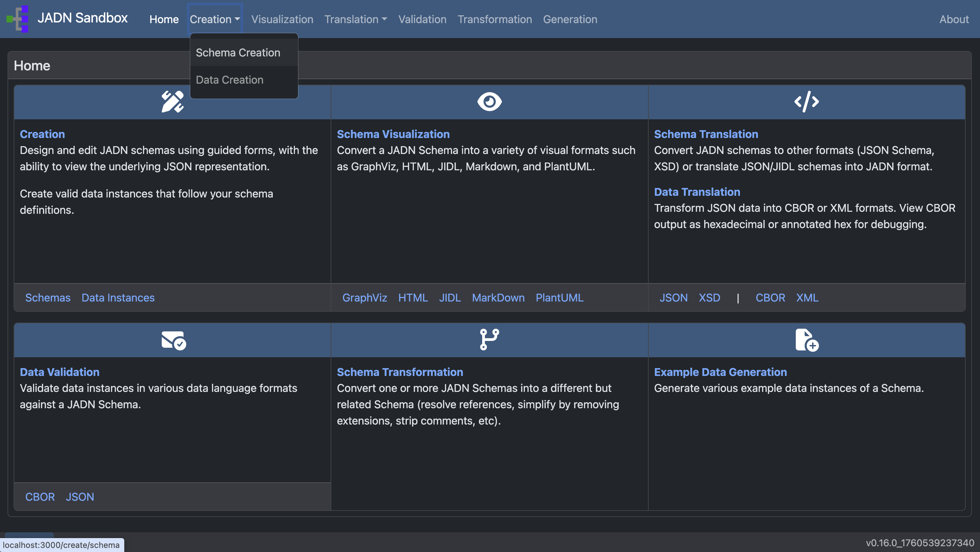
Go to: Creation
When the drop down menu appears, select Schema Creation

Slide 6
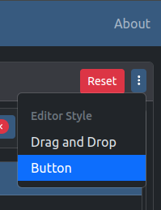
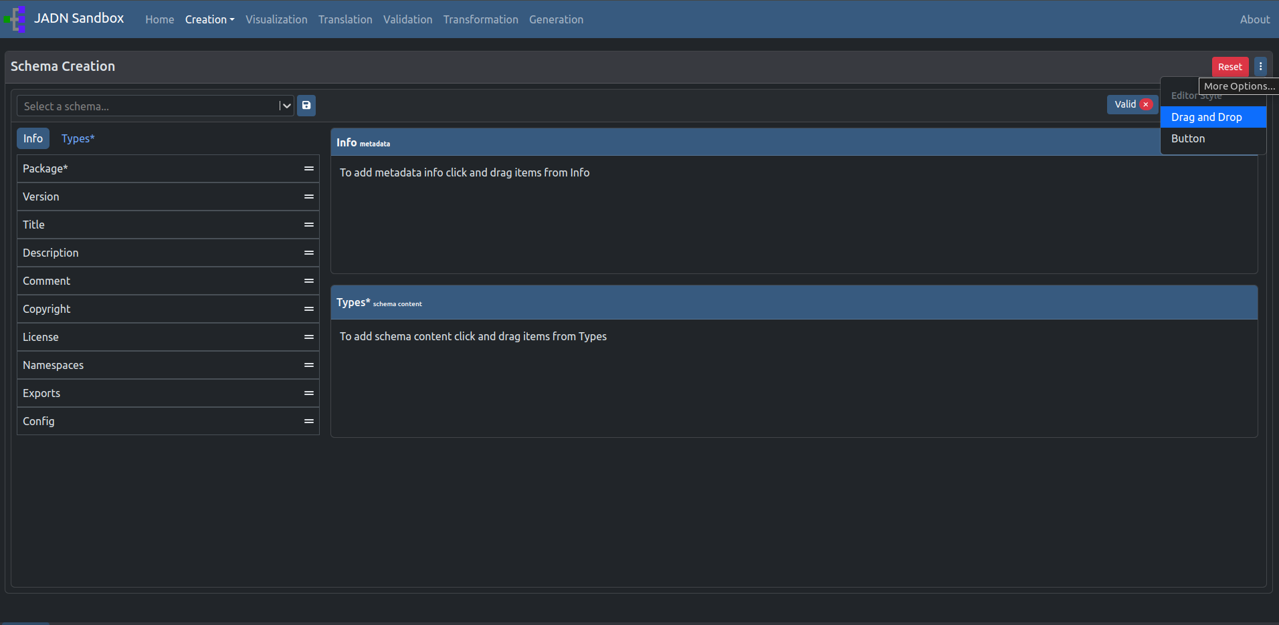
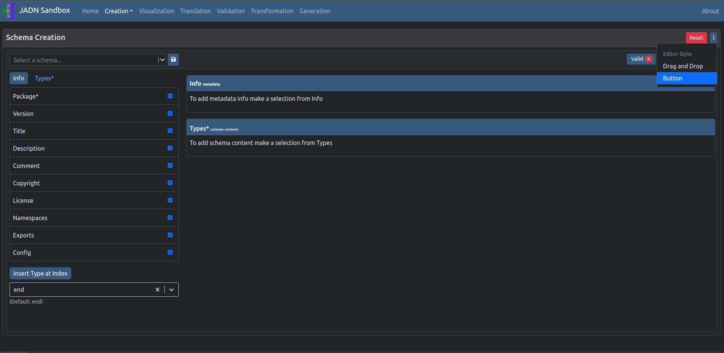
Feature: Editor Style
Choose your schema creation editor style:
Drag and Drop (default)
Button
Drag and drop style (default)
Button style

Slide 7
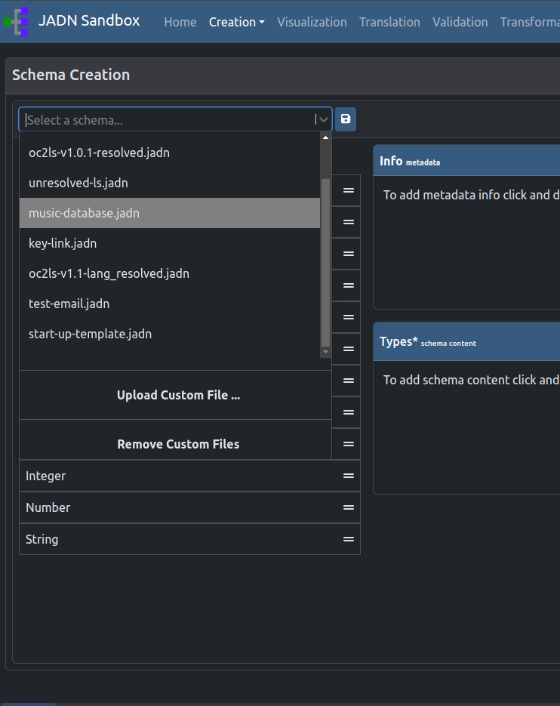
To start…
1
Select an example schema
or
Upload a syntactically valid JADN Schema
or
From scratch (blank schema)
1
2
2
3

Slide 8
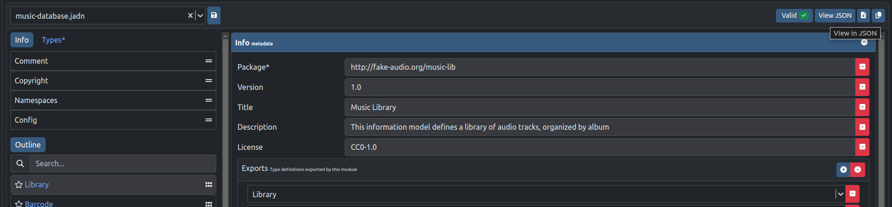
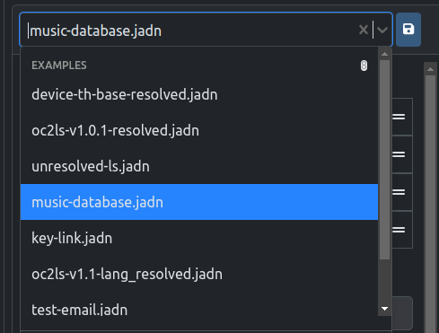
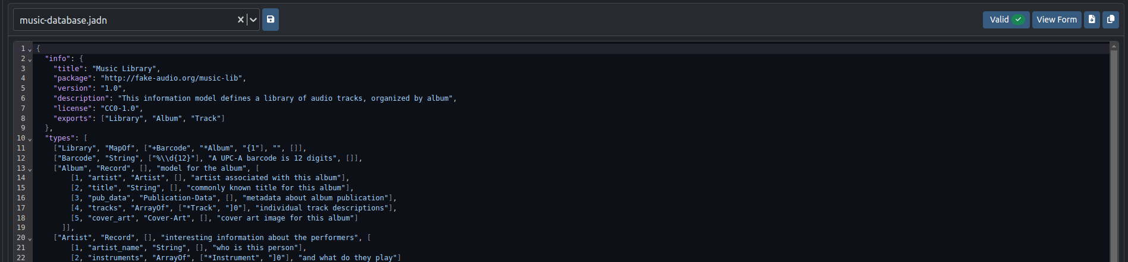

Option 1 to Start: Select a Schema
1
Selecting a preloaded Schema from the drop down menu will automatically generate the Schema in the Schema Creator.

Slide 9
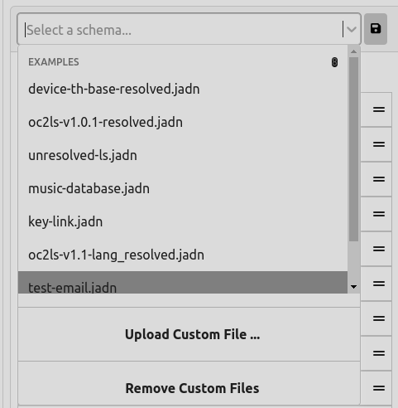
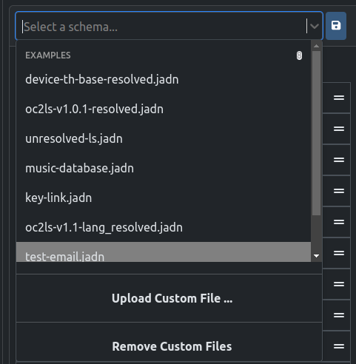
Option 2 to Start: Upload a Schema
2
Click ‘Upload Custom File…’ to upload a file using the computer’s file loader
This will upload any JADN file and then attempt to validate it.

Slide 10
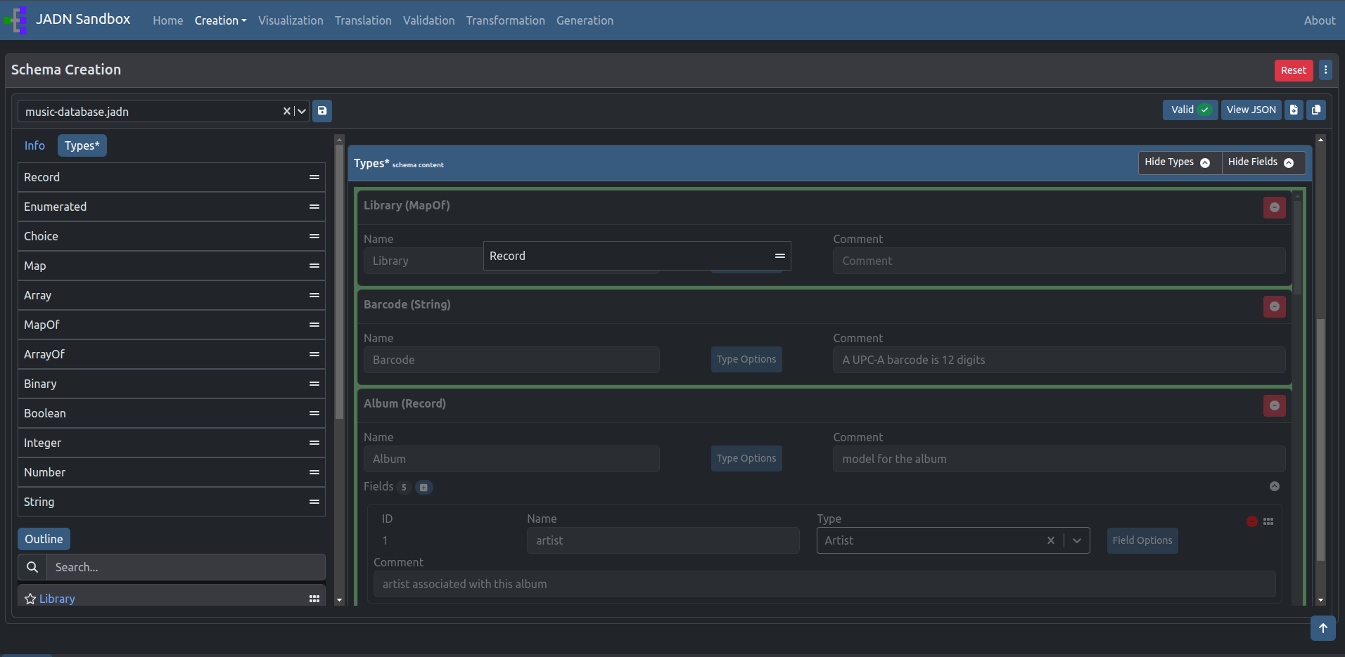
Add Data:
Drag and Drop Style
Using the default drag and drop style creator, drag items from left to right.
Drop the card when backgrounds are highlighted green.
When dragging, the background will change colors (in this case, to dark gray) to indicate where you can drop the card. It will then change to a green background when you are able to drop the card.

Slide 11
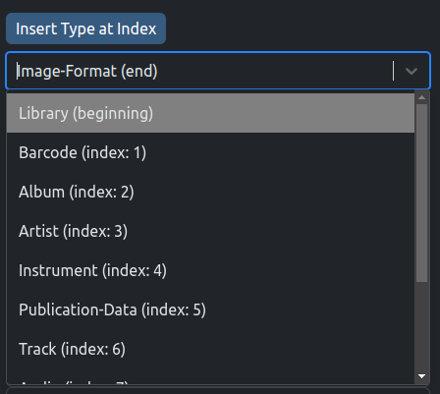
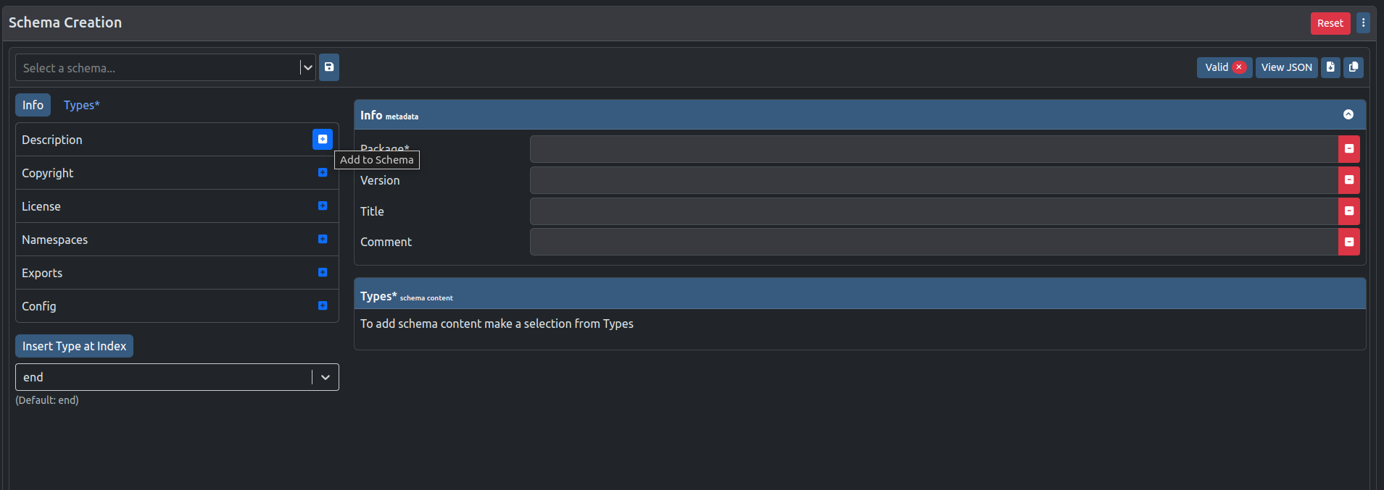
Add Data:
Button Style
The ‘Insert Type at Index’ allows you to select where you would like to add your Type. Types are added to the end of the Schema by default.
Click to add Info or Type to the schema.

Slide 12
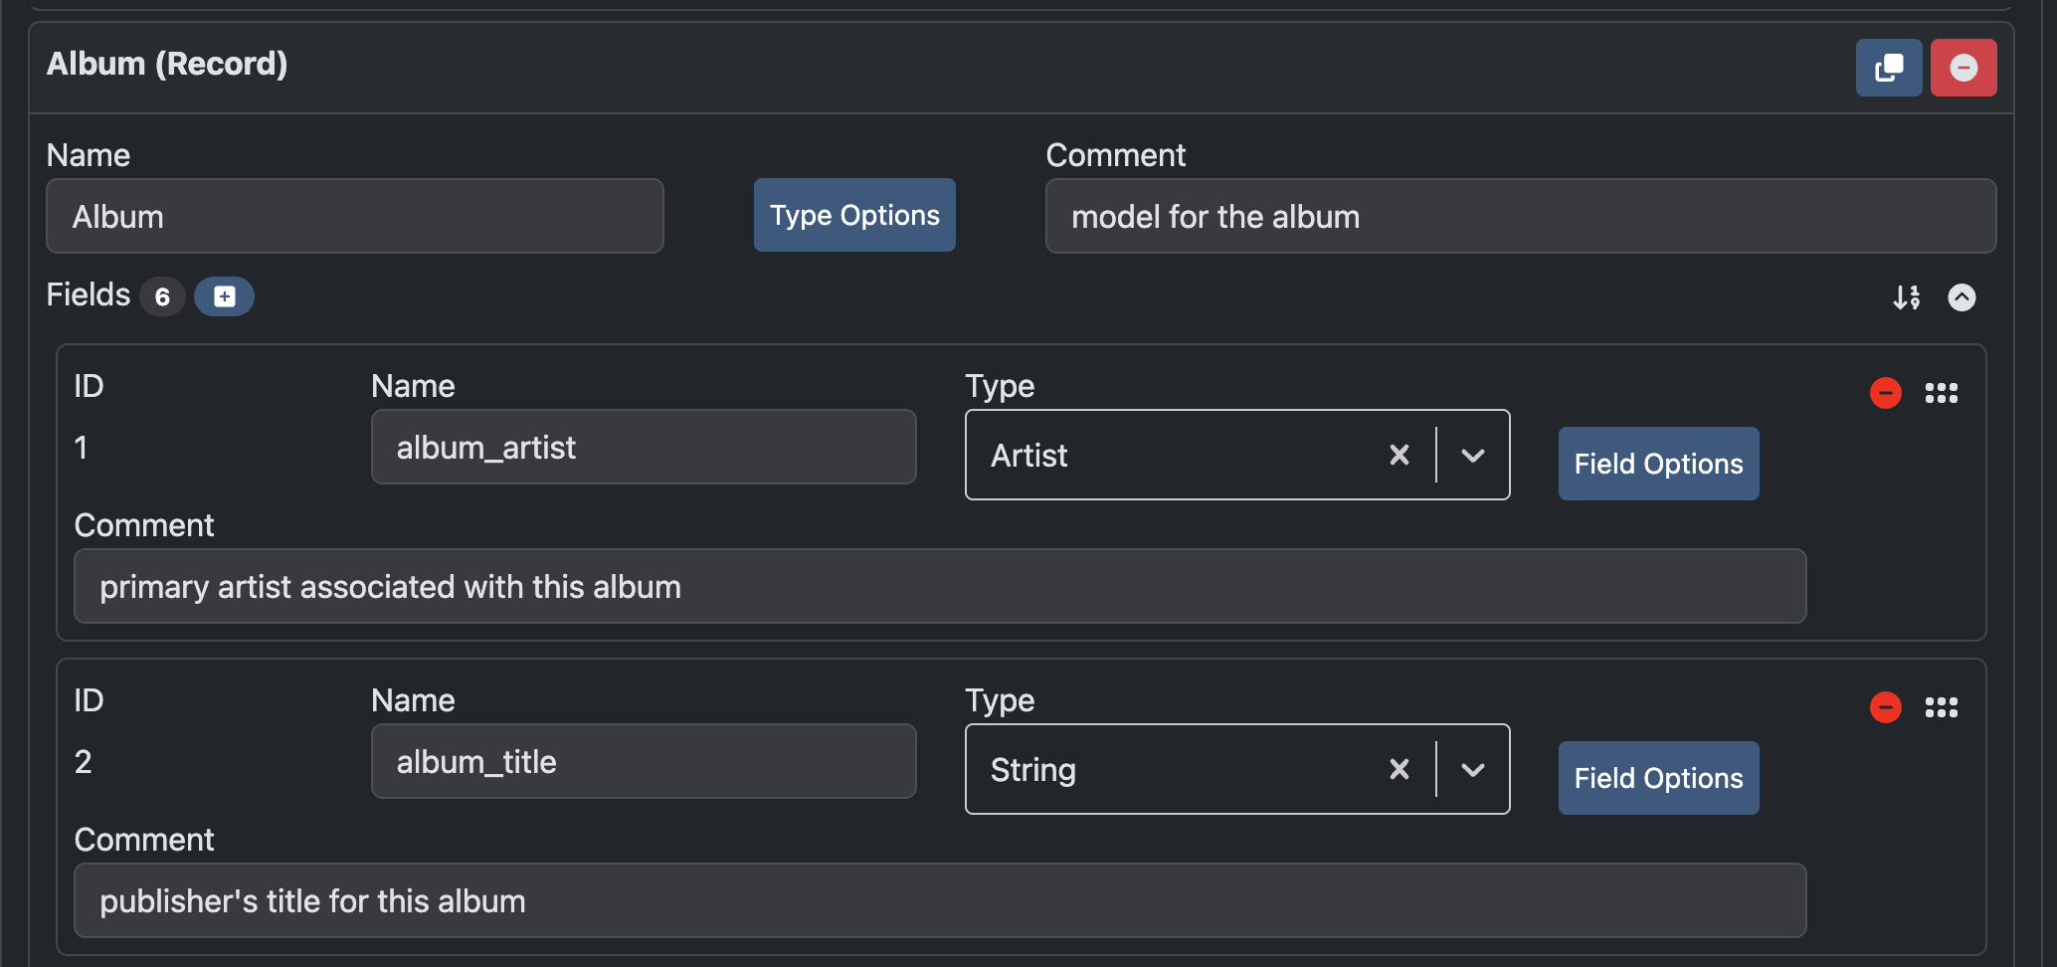




Edit Data:
Add, change, or remove Types
The cards dropped on the right can be edited by clicking within input fields
or removed .
Fields, if applicable, can be:
Added,
removed,
hidden,
easily rearranged.
Types can be:
Duplicated

Slide 13
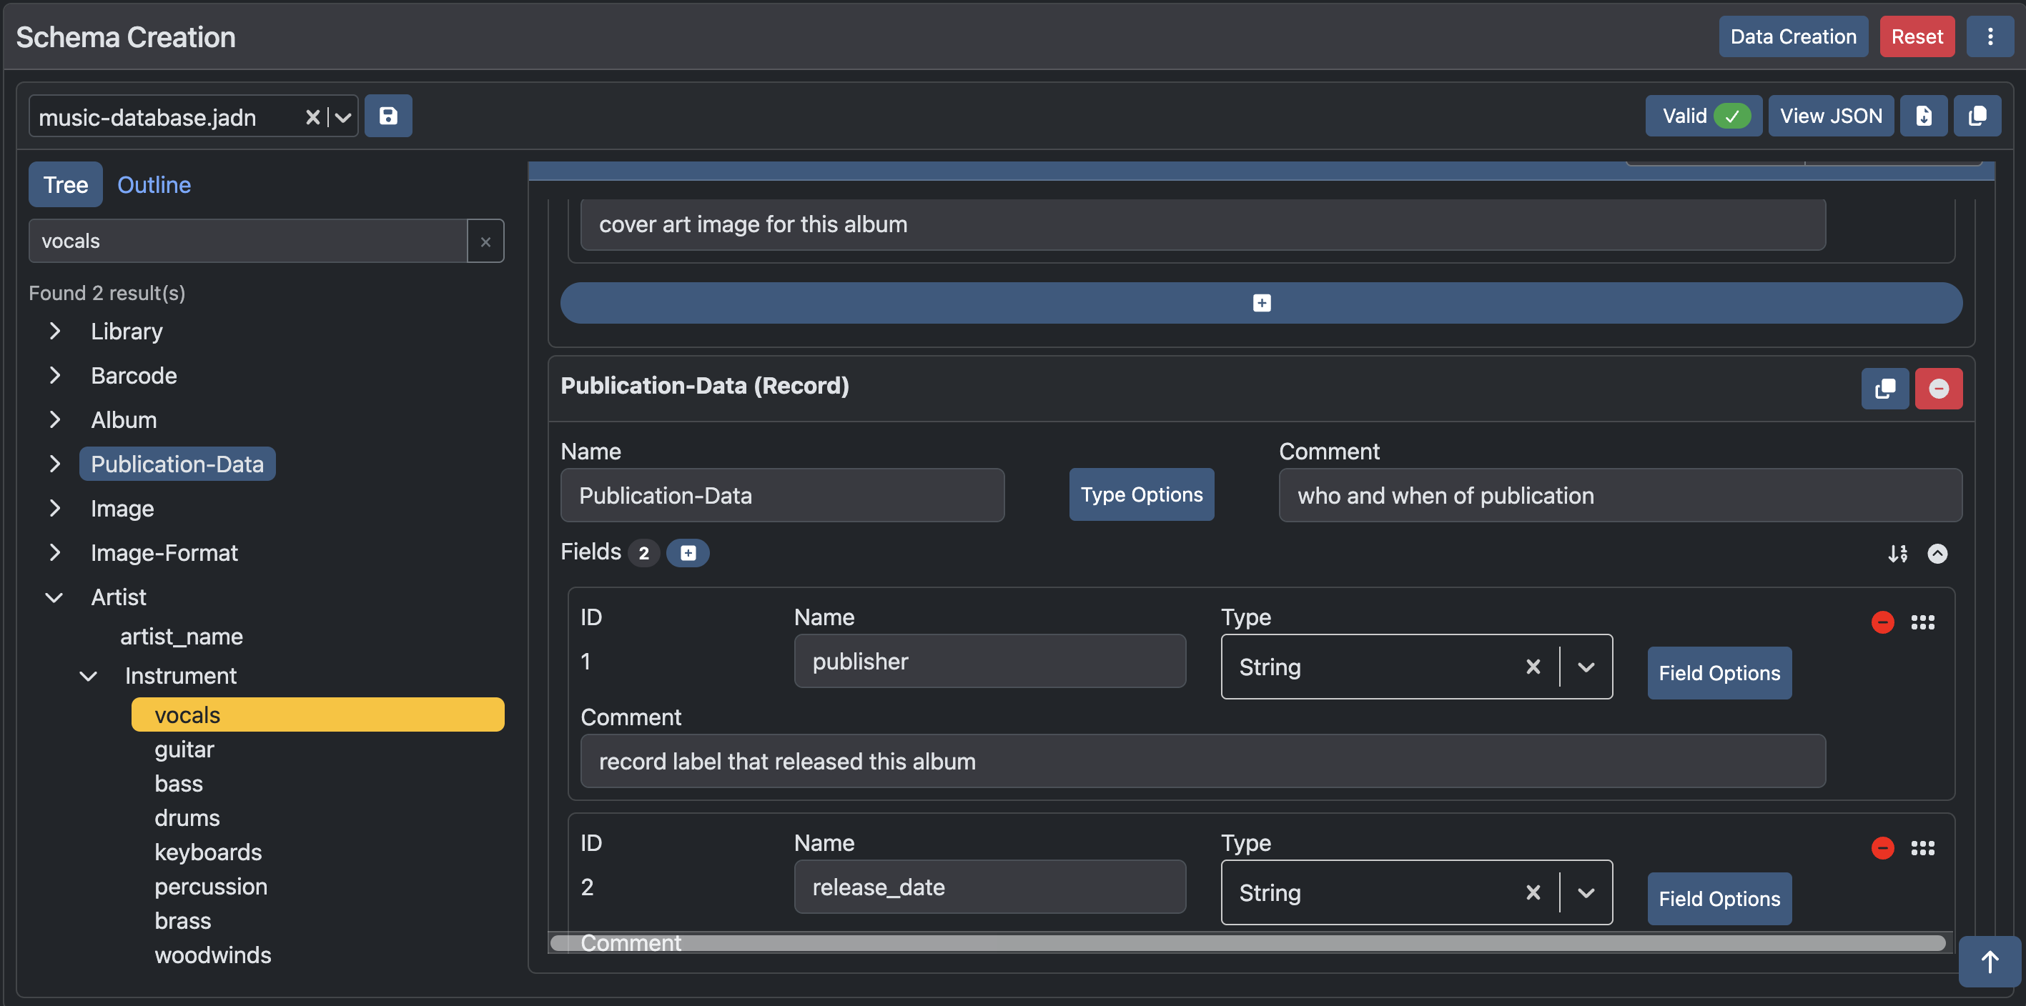
Feature: Schema Tree
You can easily navigate the entire schema tree, or search for types and/or fields.
The tree is recursive and will show a lot more depth than the Schema Type Outline shown on the next slide.
The current type will be highlighted in blue, while search term(s) found will be highlighted in yellow.

Slide 14
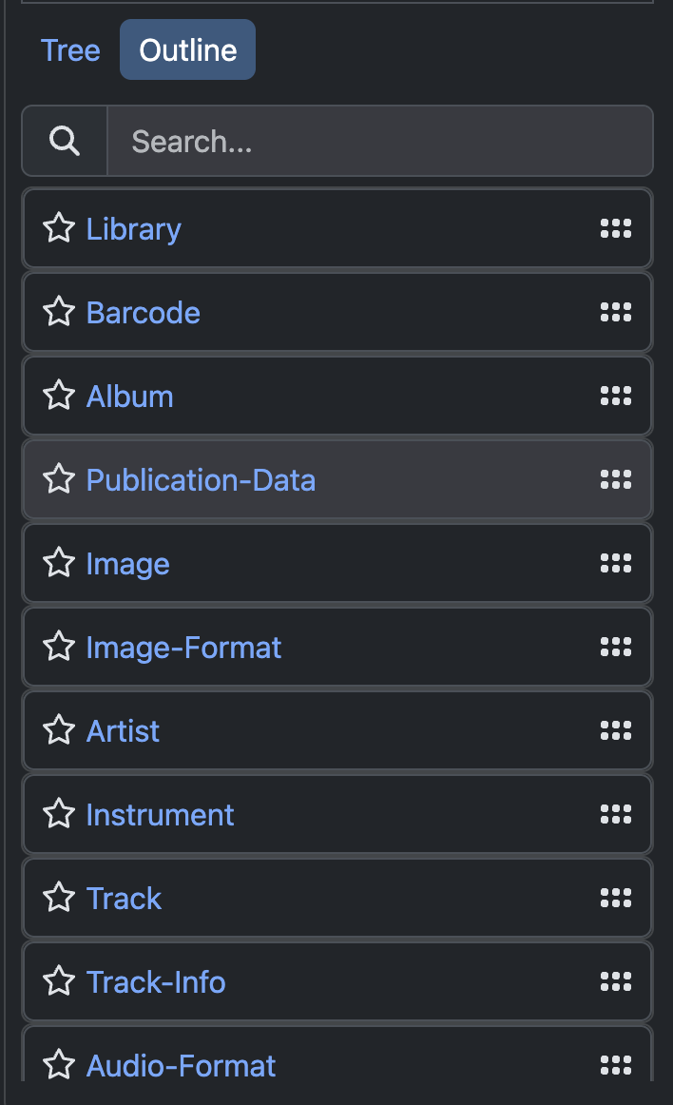
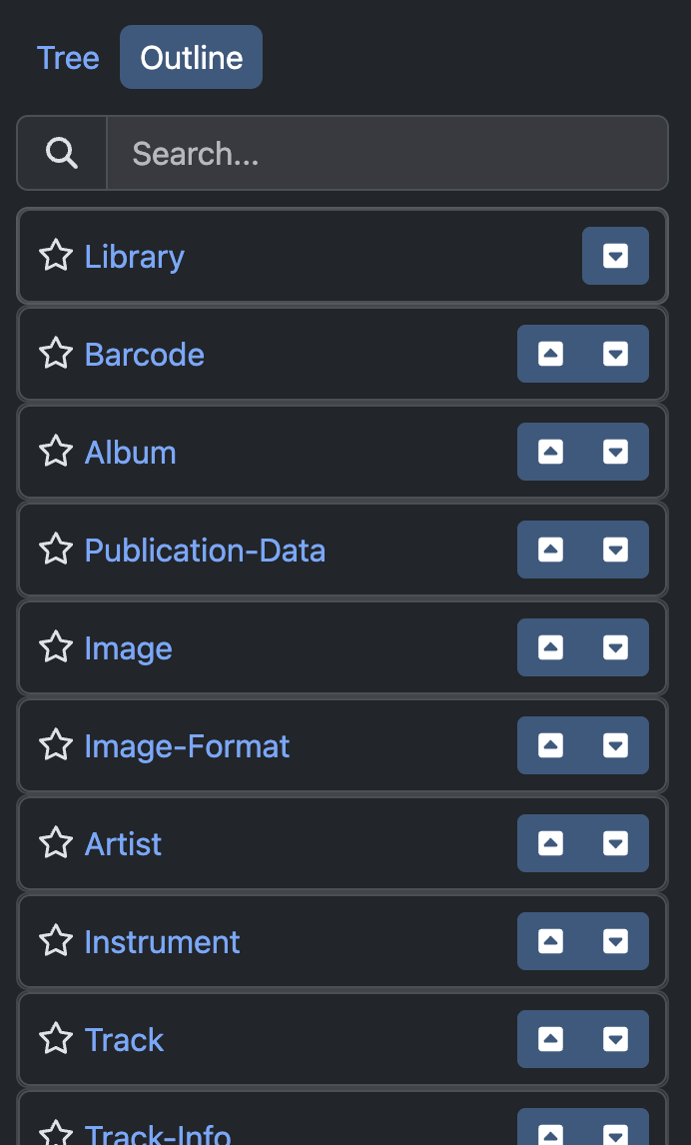

Feature: Schema Types Outline
You can easily search or rearrange the Types within the Outline.
The cards within the outline can also be starred for future reference.
Clicking on the Type Name will take you to the card in the Types section of the schema on the right.

Slide 15
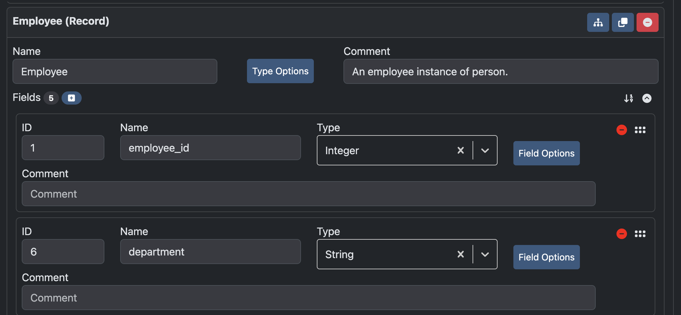
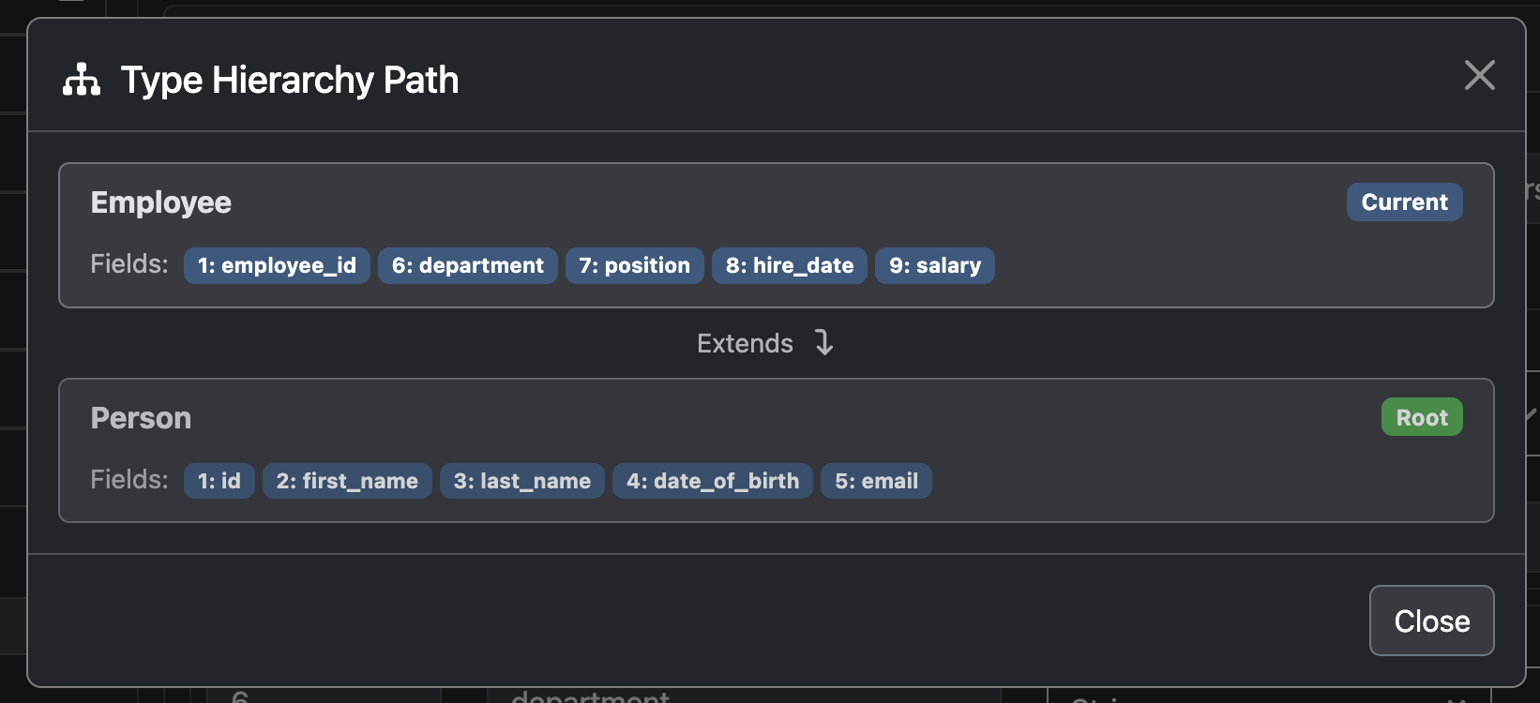
Feature: Inheritance Hierarchy Viewer
For types that inherit their fields, a hierarchy viewer is available to better visualize that relationship.
Example:
Employee extends Person.
Note: this feature is also present in Data Creation.

Slide 16
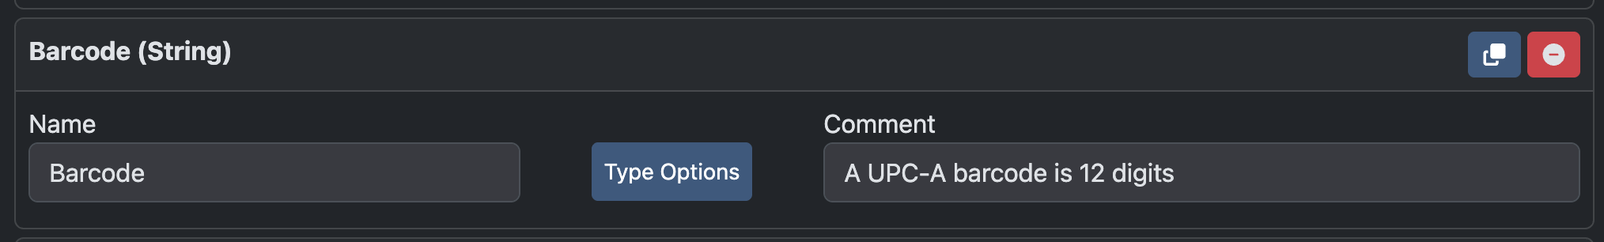
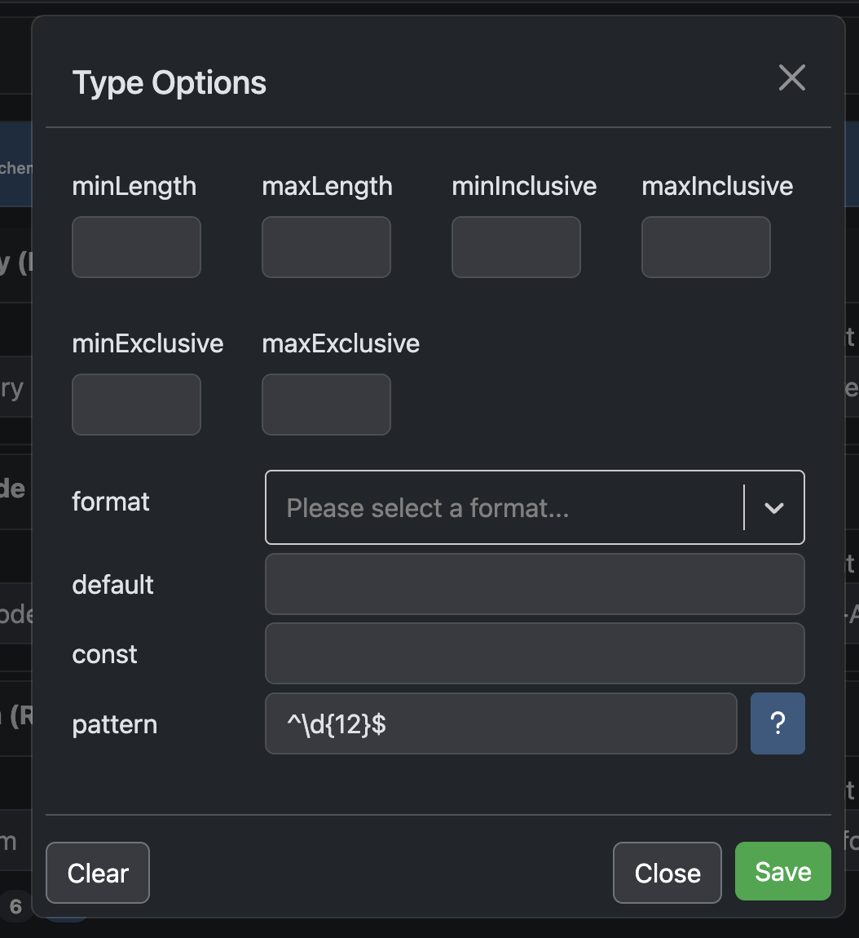
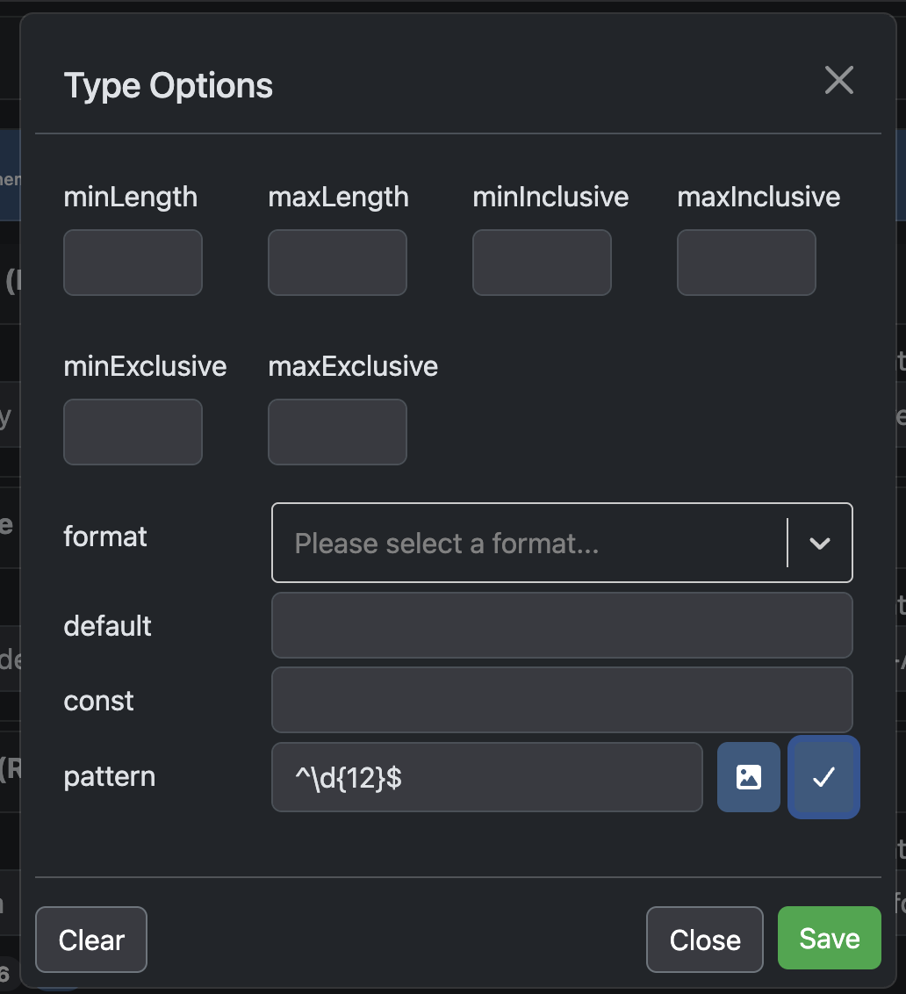
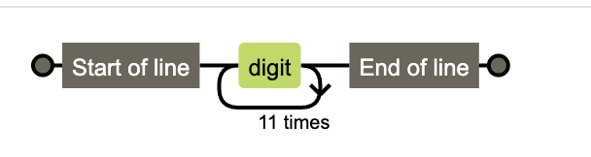
Feature: Pattern Visualizer
For types that contain patterns, the user can visualize the pattern to get a better understanding of its restrictions.
Note: this is also a feature on Data Creation.

Slide 17
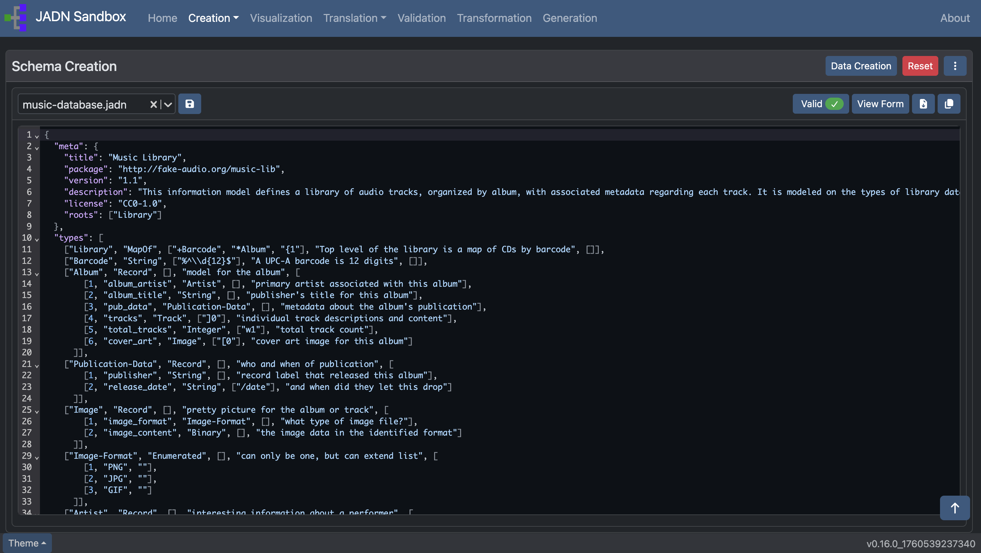
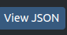
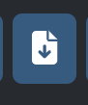


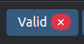
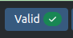
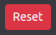
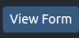
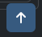
Functions
As you build your schema, you can view the JSON code by clicking on ‘View JSON’ .
This code can be:
Downloaded to your local storage
Copied to the clipboard
Saved onto the file uploader for easy selection
Other features include:
Checked for validation
Reset to start over
Scroll to top (appears when you scroll down on window)
Click ‘View Form’ to return to the Schema Creator.

Slide 18
Data Creation
Create valid data instances from a JADN Schema

Slide 19
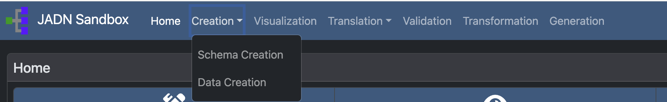
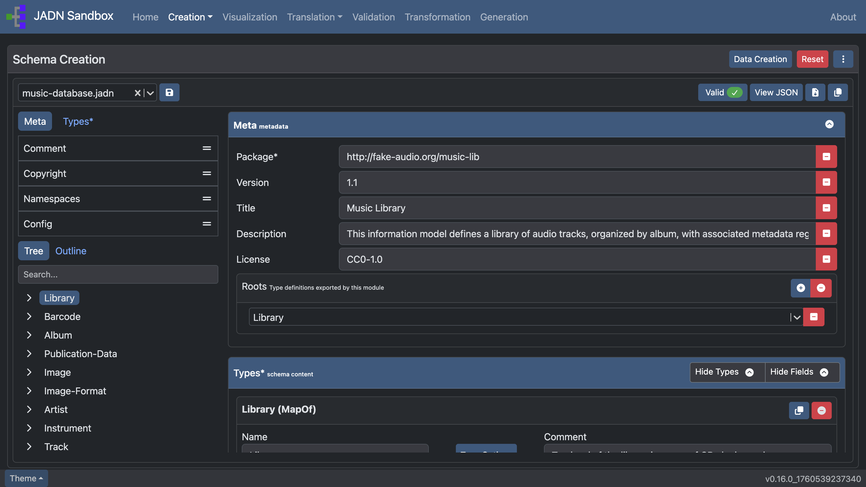
How to Navigate to Data Creation
or

Slide 20
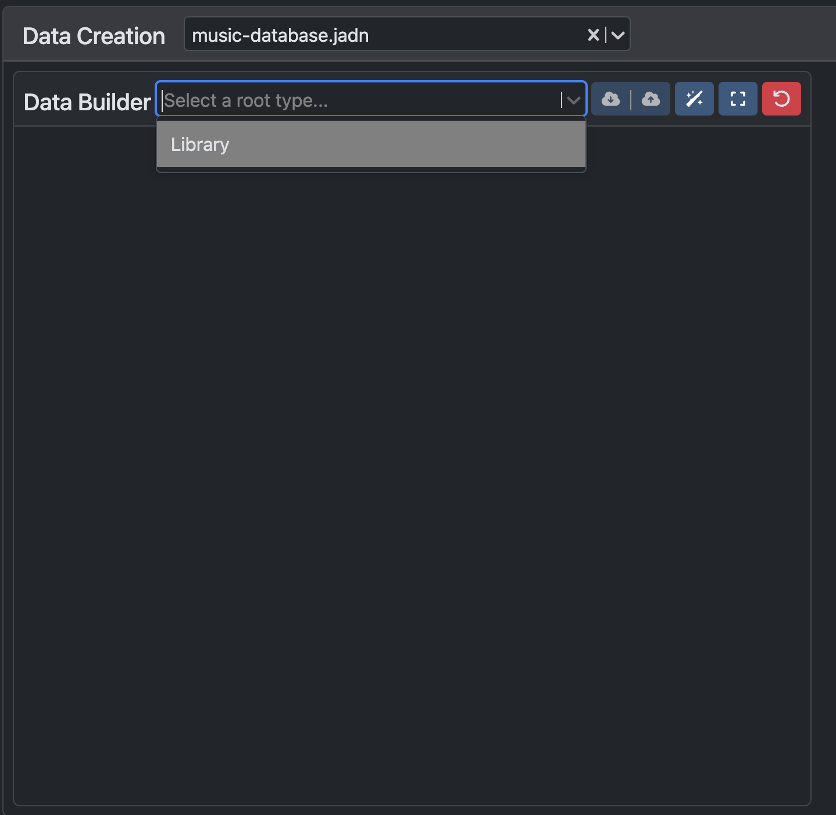
To Start : click here
Note: Only a JADN Schema can be uploaded.
After selecting a schema, you should be able to select a data type.
Note: This drop down menu is based on the Schema roots.
Once you have selected a data type, a form will appear to help guide you in building data that is valid against the selected schema.

Slide 21
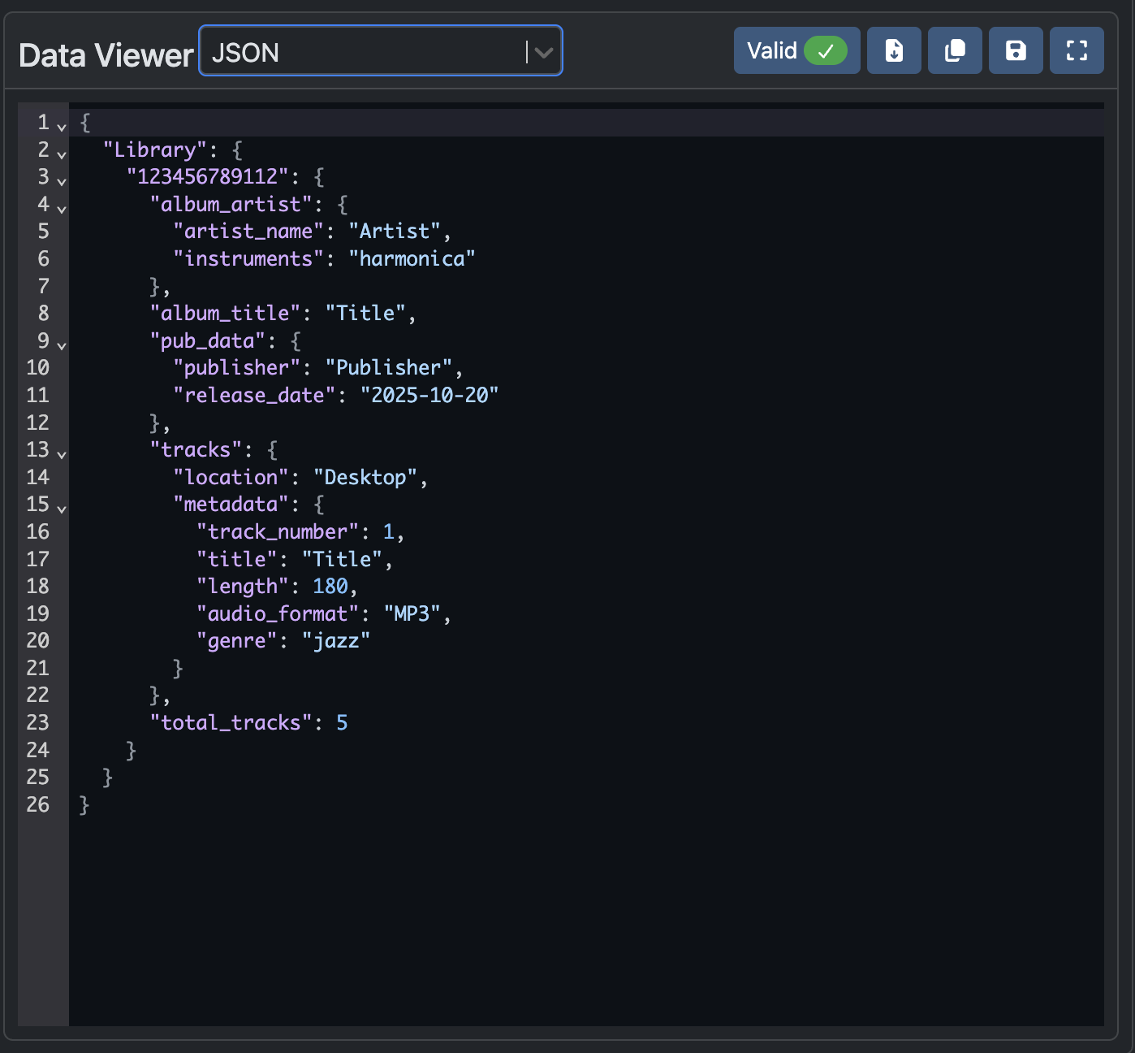
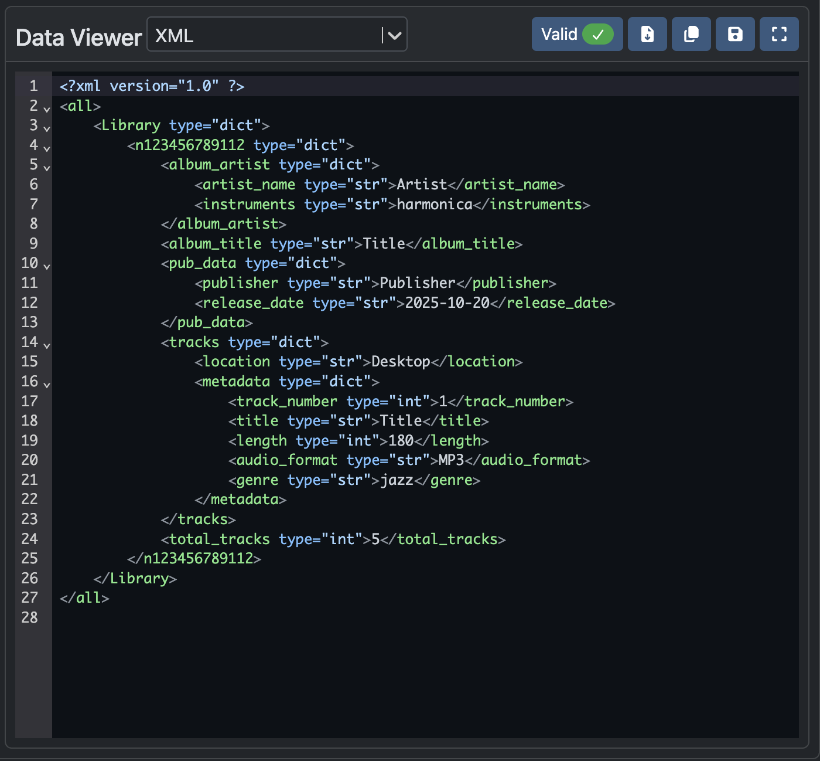
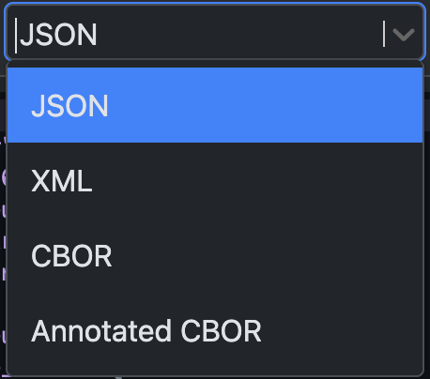
View Data
While filling out the form, you can view the JSON you are creating
Other data formats can also be viewed in real time using the dropdown.
The data can also be:
Downloaded to your local storage
Copied to the clipboard

Slide 22
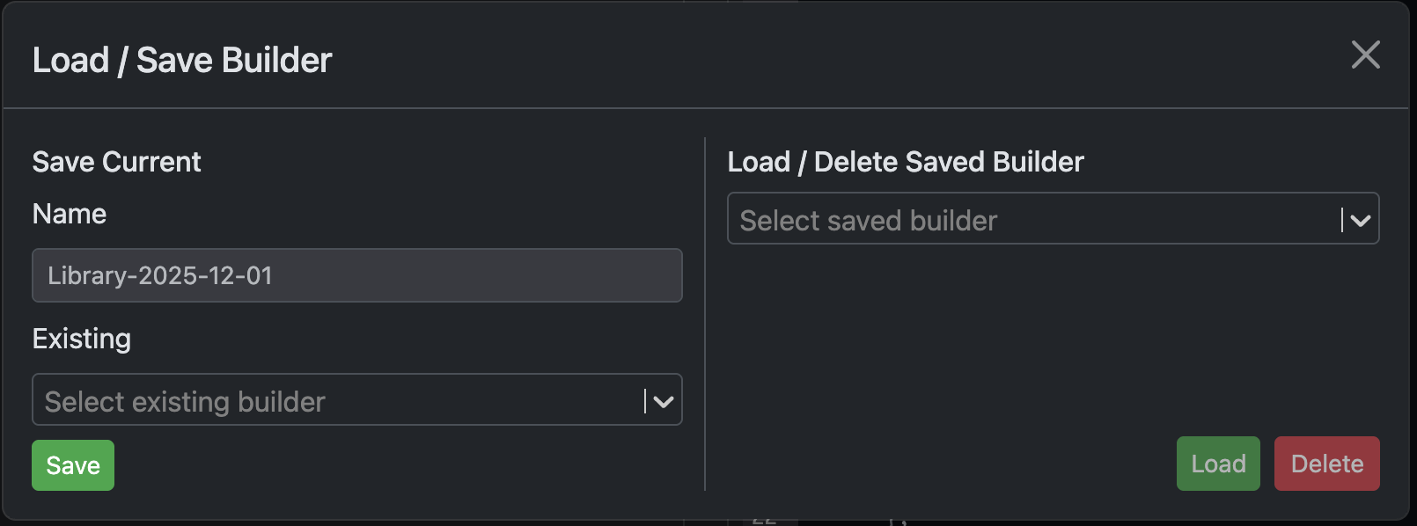
Feature: Load/Save Builder
While working on creating data from a large schema, you may need to take a break and come back later.
Load/Save builder allows you to save your current builder state and restore it at a later point.
Loading a saved state will populate the input fields and recreate the data.

Slide 23
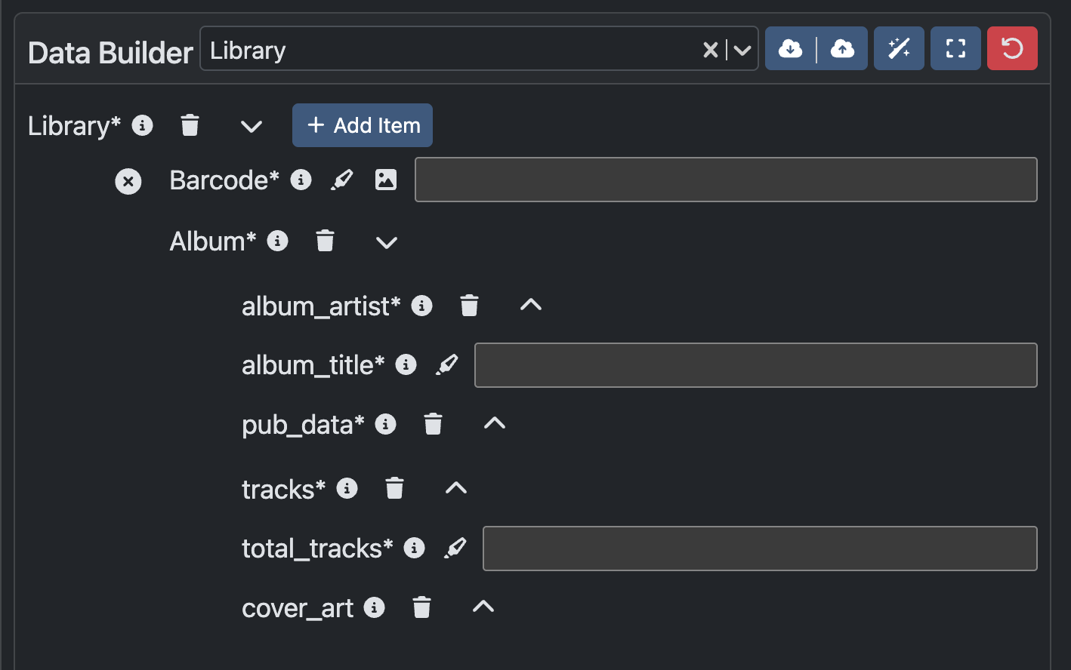
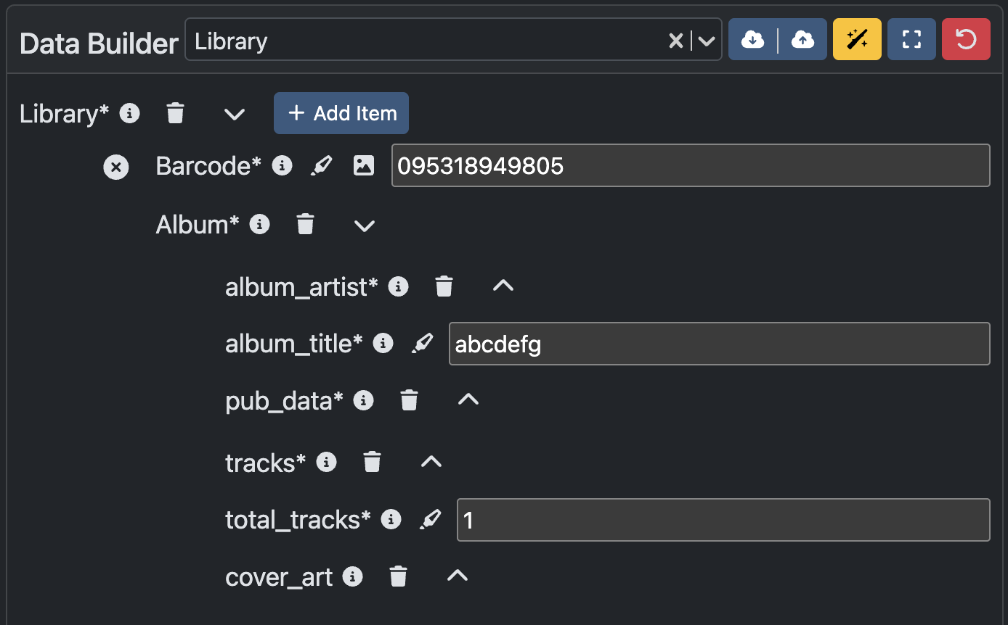
Feature: Magic Wand
While testing out schemas in Data Creation, the individual inputs may not matter. To make testing quicker, the Magic Wand feature, when toggled on, populates all present input fields.
Fields that are hidden will not be populated.
Yellow indicates toggled on, blue indicates off.
Note: the wand takes patterns, options, type, etc into account to ensure valid data.

Slide 24
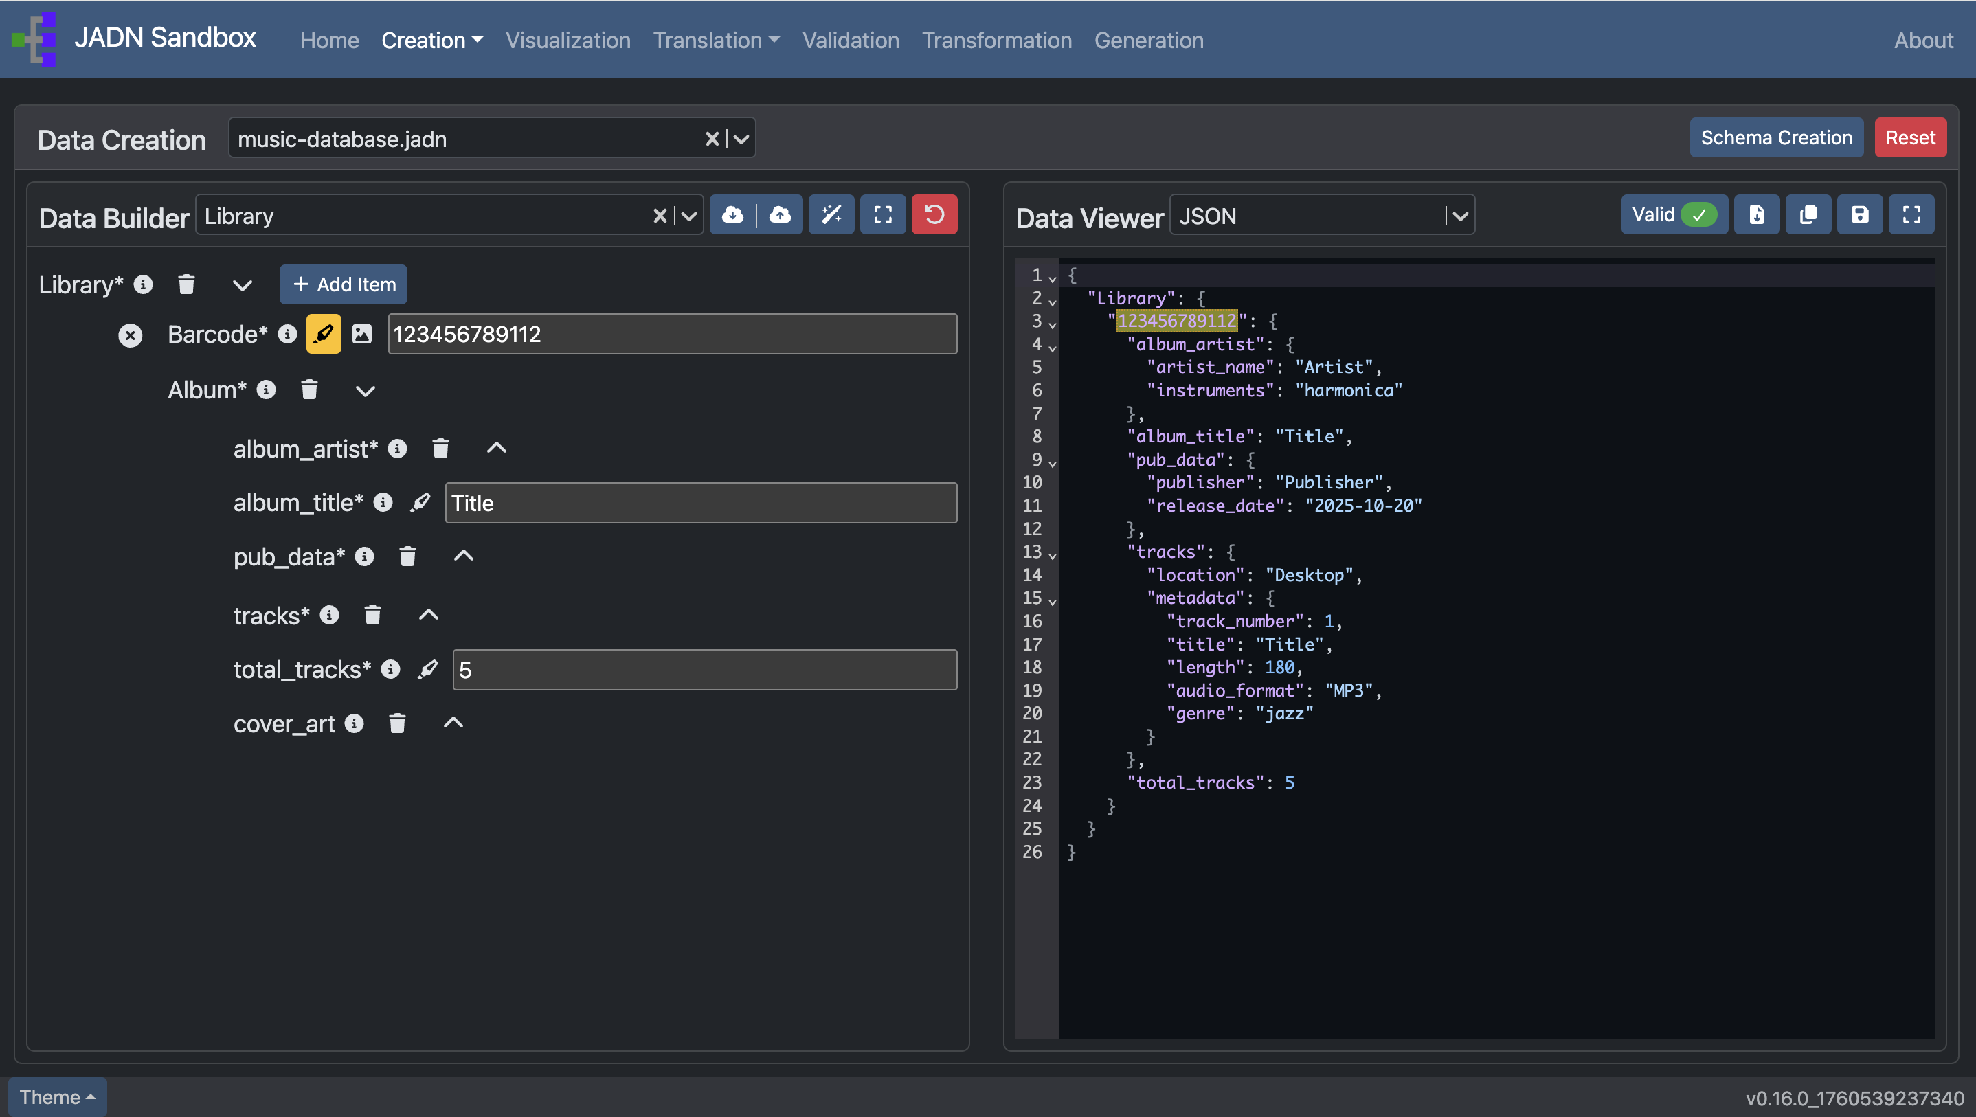
Feature: Highlight Data
While inputting data, you may want to reference previously completed data.
The highlight data function makes that easy, and works if there are multiple equivalent data.

Slide 25
Schema Visualization
View JADN schema in another language format:
JIDL¹, HTML, Markdown, PlantUML, GraphViz
JADN Interface Definition Language (IDL) is a textual representation of JADN type definitions

Slide 26
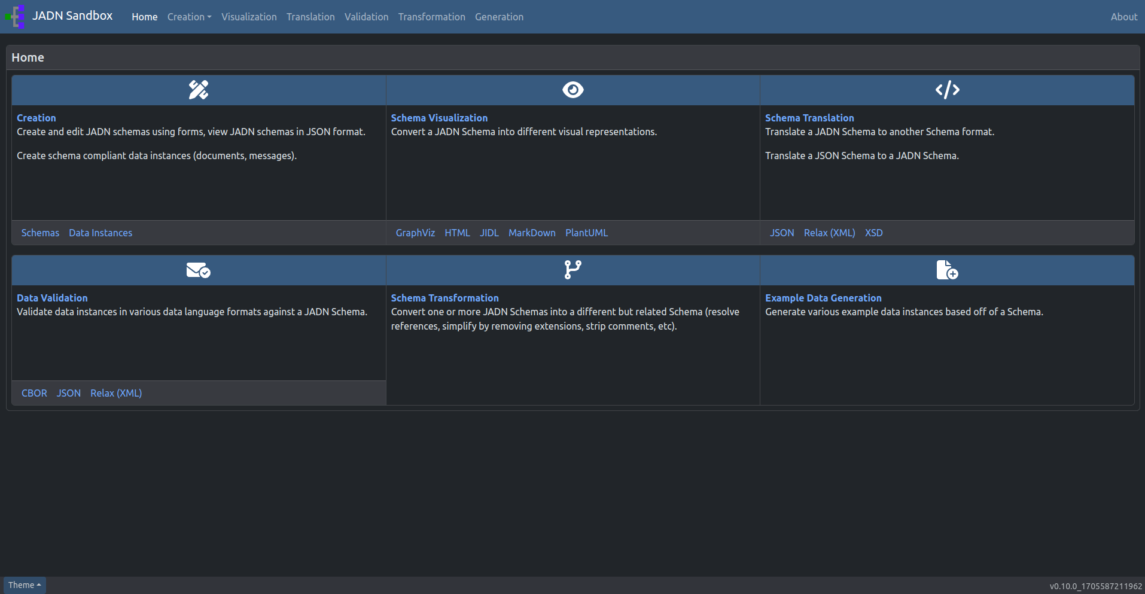
Go to: Visualization

Slide 27
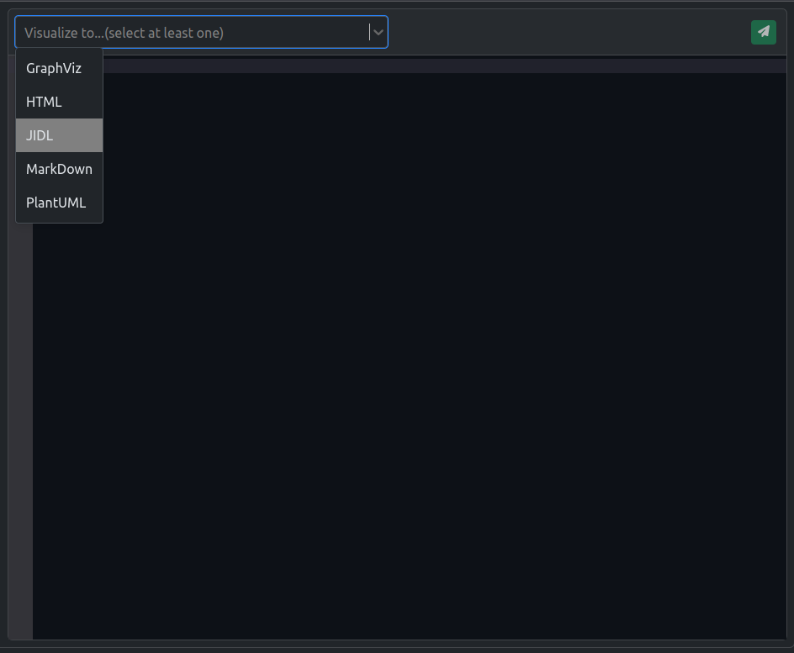
To Start : click here
Note: Only a JADN Schema can be uploaded.
After selecting a valid schema, select the desired languages you would like to convert the schema to.
Options on this page are for visual representation of JADN data. For Schema Translations (like to JSON or XML) click here

Slide 28
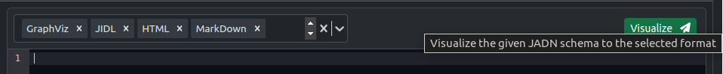
Visualize
Once you have selected the languages, the green paper airplane button should light up allowing you to proceed to visualize the schema to the selected messages.
Click the Visualize button to proceed.

Slide 29
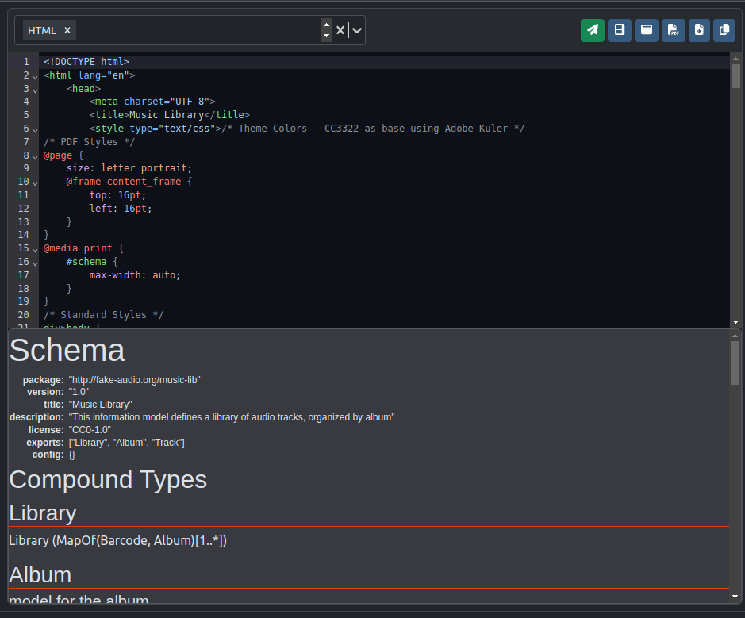






Results: Selecting one language
The result will show you the code in the selected language.
The following features allow you to interact with the visualization as you need.
Split view (currently shown) : To view the code and visualization simultaneously
Pop out : See the visualization in a new tab window
Download visualization as PDF
Download visualization as an image
Download code
Copy code to Clipboard

Slide 30
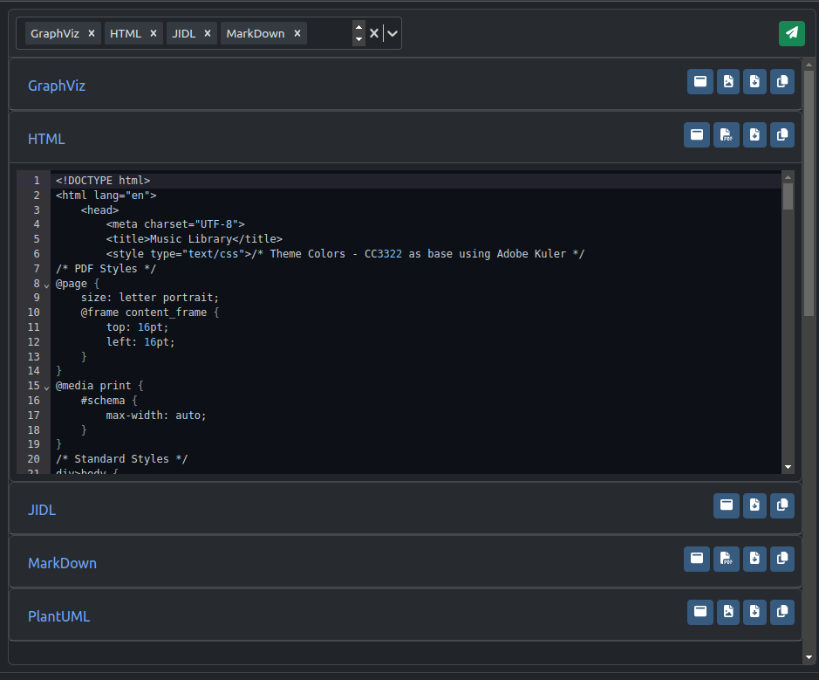
Results: Selecting multiple languages
You also have the ability to visualize multiple languages at once.
You can view the code for one or multiple languages at once by clicking on the header of each section.
Each language has its own applicable features as seen in each section.

Slide 31
Schema Translation
Convert JADN Schema to JSON , Relax XML, or XSD.
Convert JSON Schema to JADN.

Slide 32
Go to: Translation

Slide 33
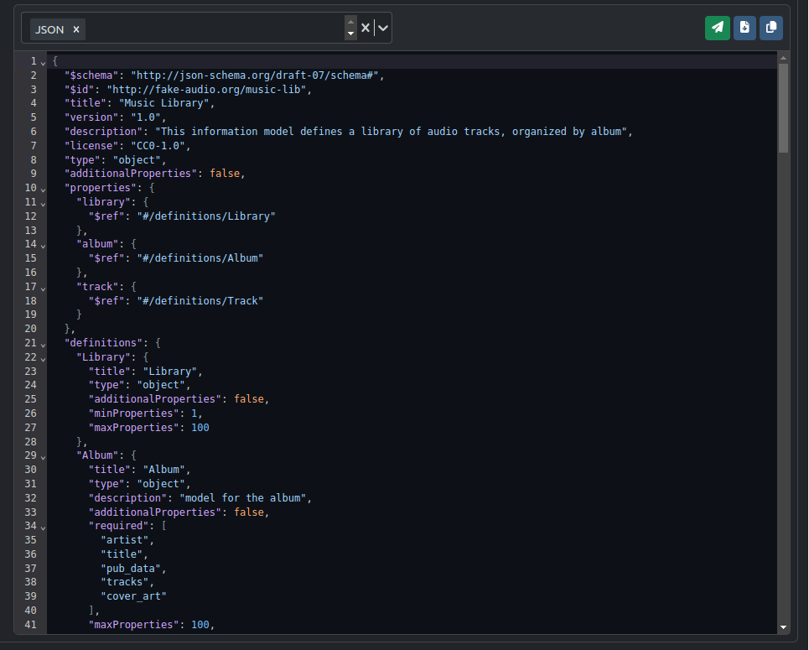
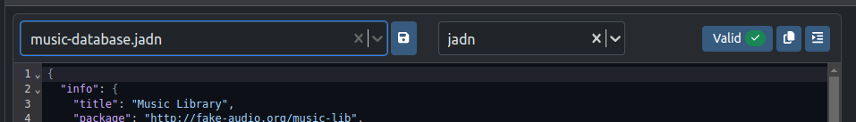
To Start : click here
Note: A JSON or JADN Schema can be uploaded.
Similar to Schema Visualization, Schema Translation allows you to translate your schema into your desired language.
When selecting a schema, make sure to select the type of schema you want to translate from: JADN or JSON.
Result: Translated Schema to one language

Slide 34
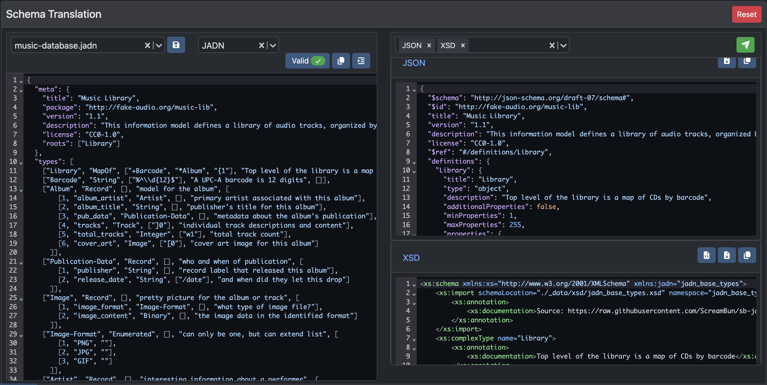
Result: Translated Schema to multiple languages
You can translate from JADN to JSON and XML (XSD or Relax) or from JSON to JADN.

Slide 35
Data Validation
Validate data instances in JSON, XML, CBOR, or JSON Compact against a JADN Schema

Slide 36
Go to: Validation

Slide 37
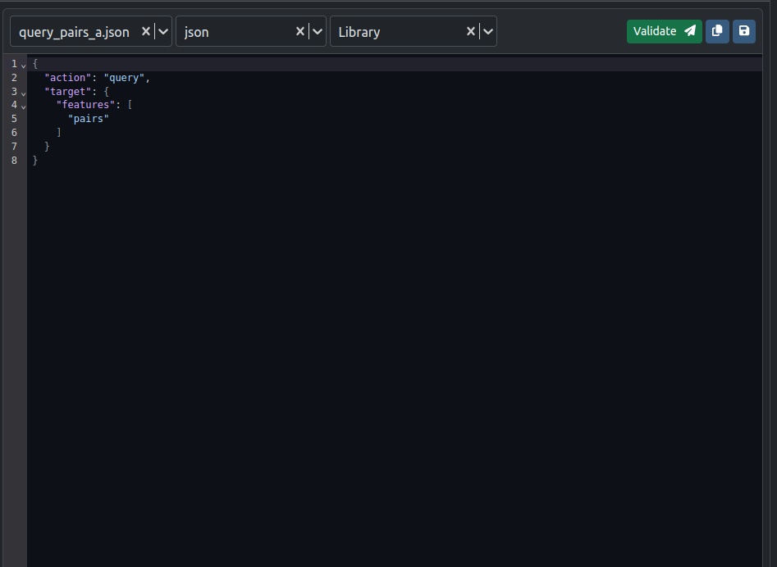
To Start : click here
Note: Only a JADN Schema can be uploaded.
1
2
3
Select data to validate.
Make sure the correct data format is selected.
Make sure the correct data type being validated is selected.
In this example, the data is a json file being validated against the Library type from the music-database.jadn
1
2
3

Slide 38

Select data to validate
1
Starting by uploading data:
Select example data
or
Upload a custom file
or
type/paste directly into code editor.
1
2
3
3
2

Slide 39

Make sure to select the correct data format
The JADN Sandbox can currently validate JSON, CBOR, XML, and JSON Compact data against a JADN Schema.
If using a data file, the data format drop down may be pre-selected.

Slide 40


Make sure the correct data type is selected
The Data types available to validate against are based off of the roots from the JADN Schema file.
In this example, notice that the uploaded schema music-database.jadn has exports that correspond to the valid datatypes:
Library

Slide 41

Validate
Once you have selected:
A Schema,
Data,
Data format, and
Data type
Click the bright, green “Validate” button.

Slide 42

Invalid Results
An invalid data file will return errors to help fix the data.

Slide 43

Valid Results
A valid data file will return a green success notification.

Slide 44
Schema Transformation
Strip comments from Schemas or Resolve a schema with references

Slide 45
Go to: Transformation

Slide 46

To Start :
Select at least one schema to upload.
Notice that there is no code editor. Therefore, schemas must be uploaded.
Here you can see 2 schemas selected to start:
unresolved-ls.jadn
ocls-v1.1-lang_resolved.jadn

Slide 47

After selecting the desired schemas, you can select your desired transformation:
Resolve references
Create a single JADN schema from an unresolved schema and its imports
Strip comments
Remove comments from a JADN schema to reduce size
or visual clutter

Slide 48


Resolve References ¹
For resolving references, you will need to select a base file. This file is the file you would like to be resolved.
The other uploaded files will be used to help resolve the chosen base file.
In this example, the base file is : unresolved-ls.jadn
A resolved Schema is a schema without references.

Slide 49
What is an unresolved Schema?
A Schema is unresolved if it has namespaces (references to types defined in other schemas).

Slide 50

Click Transform to resolve the base file.

Slide 51

Result: A resolved Schema
Notice there is no namespace and that the types from the unresolved schema can be referenced within the resolved schema.
Ls: Artifact —> Artifact
Ls: Command-ID —> Command-ID
Ls: Device —>Device

Slide 52

Result: Strip Comments
When stripping comments, results will return all schemas without comments.

Slide 53
Example Data Generation
Automatically create valid data instances given the JADN Schema

Slide 54
Go to: Generation

Slide 55
To Start : click here
Note: Only a JADN Schema can be uploaded.
Enter the desired number of examples you would like generated. This number should be between 1 - 10.
(In this example, we have selected 3.)
After you input a number, click the green “Generate” button.
Note: The button will only be clickable if you have a valid JADN schema and the number of examples desired.
Warning: Example Generation may fail due to large Schema data. As a result, the application may lock itself. In this case, please restart docker container.

Slide 56

Results
If successfully generated, you will be able to view and hide the example data generated.
For each example, you can:
Download to local storage
Save the file to data uploader (The file can then be found for easy access in the Data Validation page)
Copy to clipboard

Slide 57
Other Features

Slide 58


Theme Switcher: Choose between light and dark mode.
Note: Dark is the default theme.

Slide 59



Add custom files (Save as…)
The file saver will allow you to name and save data into a file to be found in the file loader for future use.

Slide 60

Delete custom files
Custom files can be removed from the file loader if no longer needed.

Slide 61


Download files to local storage (Download As..)
Files can be named and saved to your Downloads Folder.

Slide 62

JADN Sandbox
Docker Desktop: Startup Guide

Slide 63
Docker Table of Contents
Tips:
A Docker image is like a set of instructions. It is the template loaded onto the container to run it.
A Docker container is a self-contained, runnable software application or service created from a docker image.
How to Get the JADN Sandbox Image
How to Run the JADN Sandbox Image
From Images¹
From Containers²
From Search Bar
How to Update the JADN Sandbox Image
From Images
From Search Bar
How to Stop the JADN Sandbox Image
How to Learn More about Docker

Slide 64
How to Get
the JADN Sandbox Image

Slide 65

Click in the search bar, search: jadn

Slide 66

Then, click Pull: screambunn/jadn_sandbox

Slide 67
How to Run
the JADN Sandbox Image
From Images
From Containers
From Search Bar

Slide 68
From Images

Slide 69

Under Images, find the desired image and click the play button to run the image.

Slide 70

After clicking the play button, this window will appear.
You will need to enter information on the container to be able to run the image.
Click the carrot icon (v) to expand the Optional settings.

Slide 71

After clicking the carrot icon, you will see the settings as shown.
The Container Name is optional, but has been provided as an example (UserGeneratedContainerName1).
Note: no spaces allowed in the container name.
REQUIRED INFORMATION: Host Port - Enter: 8082
Click Run.

Slide 72


After clicking on Run, a container will appear.
Click on the link provided to open the image in a browser window.
You can also enter the link itself in the browser:
http://localhost:8082/

Slide 73

To stop the container, click the stop button.

Slide 74
From the Search Bar

Slide 75
In the search bar, search: jadn
Then, click Run: screambunn/jadn_sandbox

Slide 76
After clicking the play button, this window will appear.
You will need to enter information on the container to be able to run the image.
Click the carrot icon (v) to expand the Optional settings.

Slide 77

After clicking the carrot icon, you will see the settings as shown.
The Container Name is optional.
Note: no spaces allowed in the container name.
REQUIRED INFORMATION: Host Port - Enter: 8082
Click Run.

Slide 78
After clicking on Run, a container will appear.
Click on the link provided to open the image in a browser window.
You can also enter the link itself in the browser:
http://localhost:8082/

Slide 79
From Containers

Slide 80

First, make sure to stop any running containers.

Slide 81

Click play on the desired container and then click on link to see terminal of running container.

Slide 82

Click on the link provided to open the image in a browser window.
You can also enter the link itself in the browser:
http://localhost:8082/

Slide 83
How to Update
the JADN Sandbox Image
From Images
From Search Bar

Slide 84
From Images

Slide 85

OPTIONAL: Delete all containers related to the image (screambunn/jadn_sandbox:latest) by clicking the delete button (trash can icon) under Action.
Note: Containers use the image that it was created with. Even though the image is named the same, its versioning is different. Therefore older containers will be out of date.

Slide 86


Pulling image..
Under Images, Go to Actions and click the 3 dotted icon.
A menu drop down will appear. Click Pull.
Then go through the steps to run the image.

Slide 87
From the Search Bar

Slide 88
In the search bar, search: jadn
Then, click Pull: screambunn/jadn_sandbox

Slide 89
How to Stop
the JADN Sandbox Image

Slide 90

Click the stop button under Action in Containers.

Slide 91

Alternatively, Click the stop button within the running container

Slide 92
How to Learn More about Docker

Slide 93

Go to the Learning center to learn more about Docker.

